Slide 1

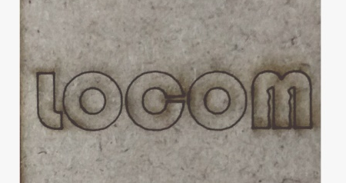
Head Movements Tracking Device For Patients With Locomotor Disability
S.T.E.A.M. School: MAKER’S ASYLUM

Slide 2
Problem Statement
Statistics: 61 lakhs Disabled
To Enable People With Motor Disability To Use Gadgets
Existing Solutions:- Costly and Inconvenient

Slide 3
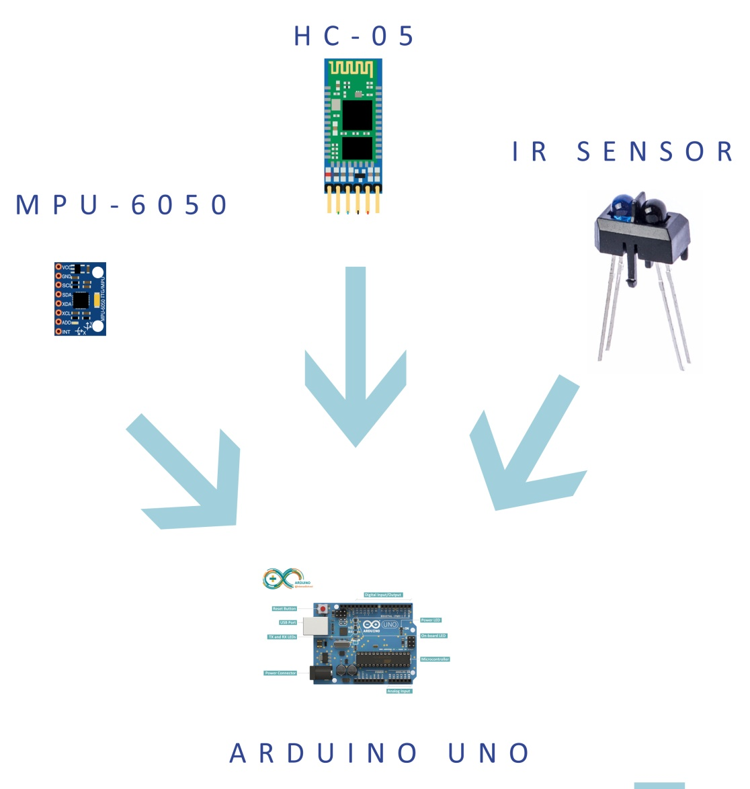
Concept
Head Movements
To
Cursor Control
Blinks
To
Click

Slide 4
User Prospective
Cost: ~ $20
Place in Community: Gaming, Education, Driving, Home Automation, etc.

Slide 5
